Slide 1
Introduction to Records Management and Retention
UNT System
University Integrity and Compliance
Version 2 ; 3.2018

Slide 2
Training Topics
What is Records Management?
What is a Record?
Why do we “manage” our Records?
Why Records Management?
Records Copies Vs. Convenience Copies
Roles and Responsibilities as a Records Management Representative (RMR)
Identifying a Records Management Representative
Identifying yourself as an RMR
What is the Records Retention Schedule (RRS)?
How to use the Records Retention Schedule
What are RRS Codes and Explanations?
Disposition and Proper Disposal of Records (Including confidential records)
Legal Holds
Recycling
Accessing, completing and submitting a Final Disposition Log
University Archive and Archivist
Records Management Plan (RMP)
Document Type Requests

Slide 3
What is Records Management?
Records Management is the application of management techniques to the creation, use, maintenance, retention, preservation and destruction of records for the purposes of improving the efficiency of business operations.
Each business unit under the UNT System has a responsibility to preserve and protect all records that are under its control.
Texas law requires that official state records:
Be identified and categorized based on their function in the state government.
Be retained for periods specified by law or by good business practice (if no law applies).
Have their disposition documented in a log, after their retention period has ended.

Slide 4
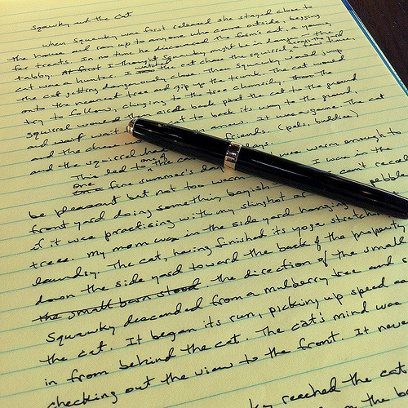
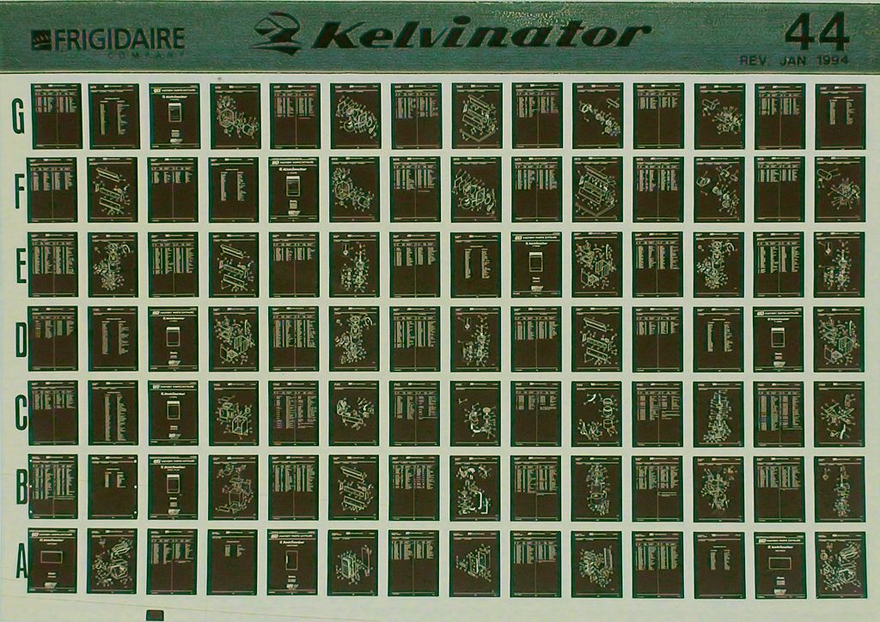
What is a Record?
Official Definition: State law defines a state government record as "any written, photographic, machine-readable, or other recorded information created or received by or on behalf of a state agency or an elected state official that documents activities in the conduct of state business or use of public resources. (Texas Government Code, §441.180)
Record - any document that describes the operation of a state agency, plans that it makes, official actions it takes, or information it receives.
Records can be on paper, on microforms (microfiche or microfilm), or in electronic formats (images, emails, electronic files, databases).

Slide 5
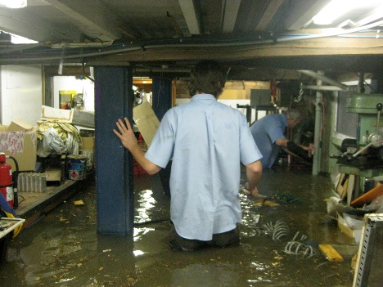
Why do we “manage” our Records?
Space
Business Continuity (Emergency Preparedness)
Operations
Legal Compliance

Slide 6
Record Copies vs. Convenience Copies
A Record Copy is the document kept on file as an original or official record for the total retention period.
A Convenience copy is a duplicate of a record copy used for reference purposes.
Care must be taken in determining if duplicate records are indeed convenience copies. It is possible for the same document to be present in two or more units of the institution and all are record copies if they serve a different function in each unit.
Note: When the official copy of a record is disposed/destroyed, ALL convenience copies should also be disposed.
If all convenience copies are not disposed/destroyed, the remaining copies become the official records copy.
In legal proceedings, audits, administrative reviews, etc. – copies can be used as an official record.

Slide 7
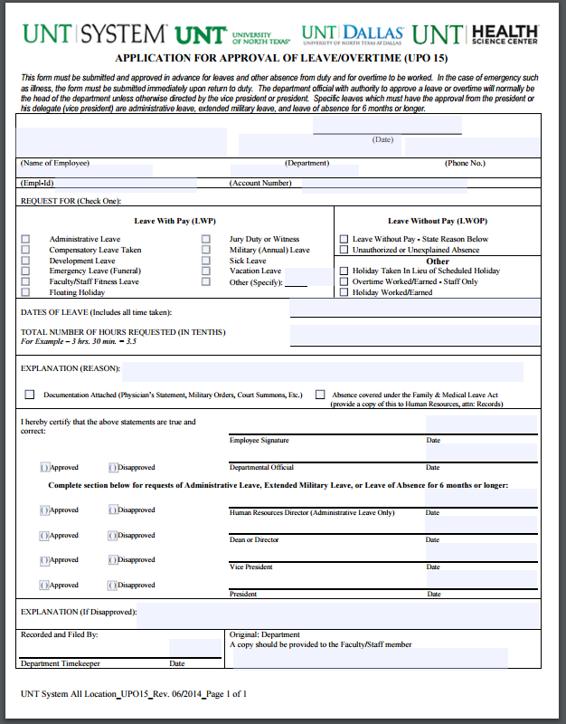
Which one is the original?
Scanned
Paper

Slide 8
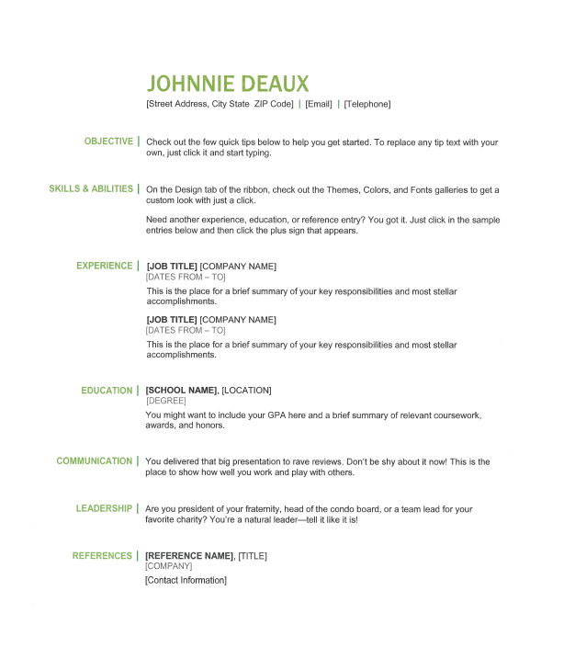
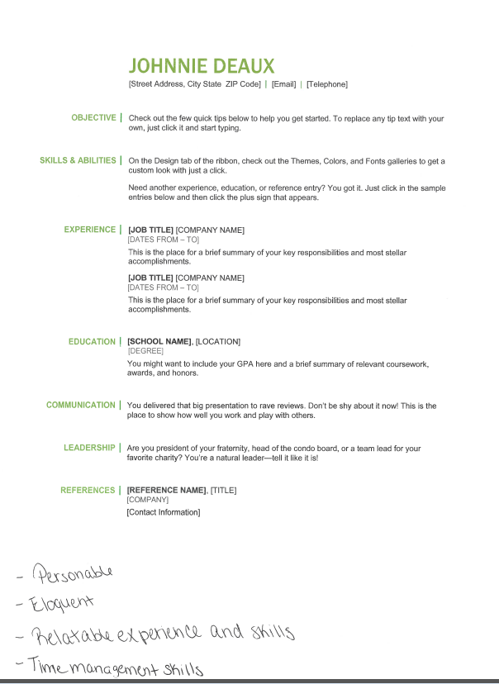
Which one is the original?

Slide 9
Which one is the original?
You have a form in which persons make request(s). The person completes this document and your unit inputs the information in your electronic system.

Slide 10
Roles and Responsibilities as an RMR
A Records Management Representative (RMR) is the subject matter EXPERT for the records in their unit.
Attend records management trainings suggested by the Institutional Records Management Program and the Office of Institutional Compliance.
RMRs are required to attend a refresher training every 2 years.
Serve as the representative from their unit for the creation, approval and implementation of the unit’s records management procedures.
RMRs for academic units are responsible for keeping the faculty up-to-date with records keeping processes.

Slide 11
Roles and Responsibilities as an RMR
An RMR will directly associate the units records to the Records Retention Schedule, complete the Final Disposition Log (FDL) for records that are to be destroyed or disposed of and send the log to the appropriate administrator for approval. Once the FDL is approved by the unit administrator, the RMR will send it to the Institutional Records Management Program in the Office of Institutional Compliance for approval to dispose or destroy.
An RMR is one or more persons who actively creates, maintains and manages their unit’s records using a records management plan (inventory).
An RMR notifies the Institutional Records Management office when a new RMR is appointed for your unit.
Notes:
Kari

Slide 12
Identifying an RMR
Each unit will identify an RMR and an alternate RMR.
The RMR and alternate RMR must be full-time staff or faculty.
An RMR CANNOT be a student.
Consider the following for each unit:
The size of the unit and volume of records maintained in the unit.
Some units may need to have multiple RMRs depending on the size of the unit.
Staff that lead the maintenance and operation of unit records on a regular basis.
RMRs should have direct reporting access to unit administration and management and should have access or authority to enact change in departmental recordkeeping processes (including physical and electronic records processes – as needed).

Slide 13
Identifying yourself as an RMR
If you are the RMR for your unit, you must designate yourself using the RMR Designation Form found at records.unt.edu/rmrs.
On the left side of the screen choose “RMR Designation Form”
Follow the prompts until complete
Select “Submit”
Please include your “special area” within the unit in the RMR Designation Form
RMRs/Alt RMRs register for required Records Management Training at my.unt.edu
If you are no longer the RMR or alternate RMR for a unit, please fill out the “RMR Update Form.” This form can also be found at records.unt.edu/rmr.

Slide 14
What is the Record Retention Schedule?
The RRS is managed in accordance with Texas Government Code Chapter 441.
The State of Texas has a Records Retention Schedule (RRS), in which all State agencies must use as a guideline in creating and maintaining their Records Retention Schedules.
The RRS combines applicable federal and state laws, regulations, internal policy, best practices and current organizational processes that affect records management.
The UNT System Consolidated CORE Records Retention Schedule (RRS) is the policy of the University.

Slide 15
What does the Records Retention Schedule do?
Tells how long to retain a record that belongs to a “Record Series” (i.e. a certain category of document).
Tells the specific characteristics of the records (i.e. final repository, archival, vital, historical, etc.).
It prescribes the time period following a reference event that a record series must be retained.
The reference event can include these:
The end of a fiscal year or calendar year
The date when a file is closed by law or policy
The date when the file no longer has value

Slide 16
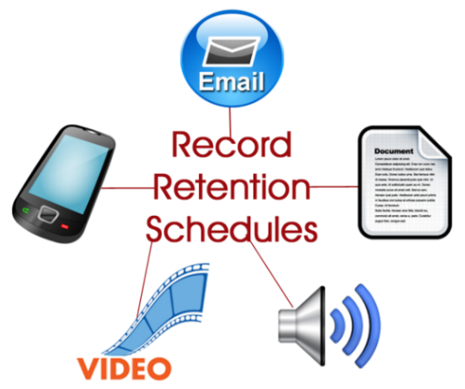
How to use the Records Retention Schedule
The UNT System Consolidated CORE Records Retention Schedule is available as an online tool on the records management website at records.unt.edu/untsysccrrs or records.unt.edu and click the “Retention Schedule” tab.
If your unit is listed as the Final Repository, you are responsible for the final disposition of the record copy. If you are not listed as the final repository, you may still be responsible for the disposition of the record if it has a function in your unit.
What to consider if you are not listed as the Final Repository:
Why does the unit keep this record?
What is the purpose of the record in this unit?
Is it necessary to the daily operations for the unit?

Slide 17
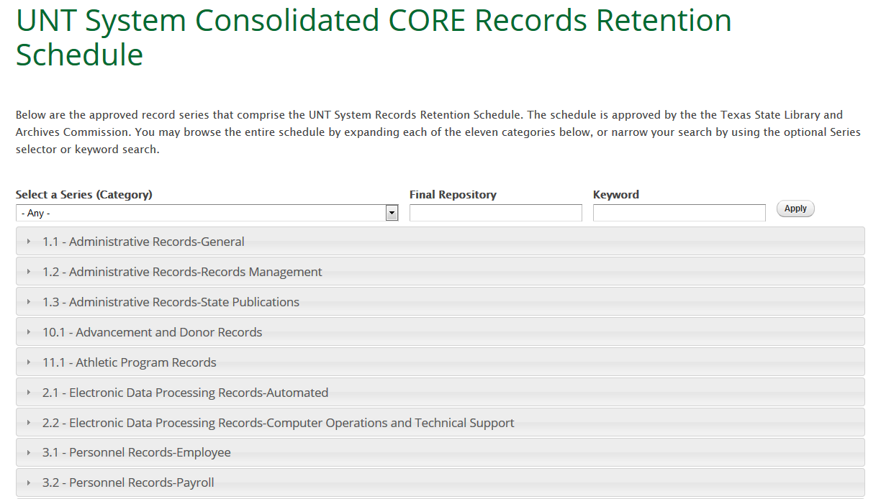

Slide 18
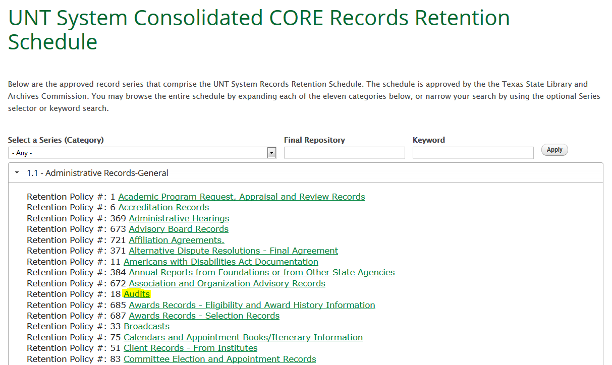

Slide 19
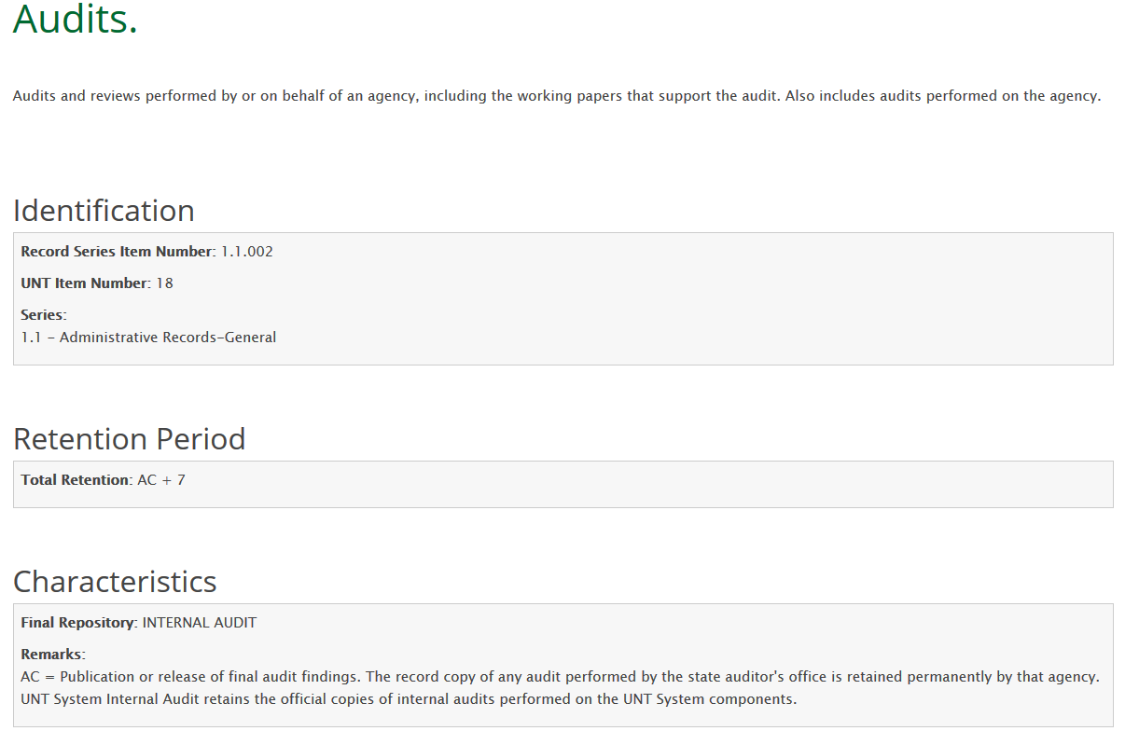

Slide 20
What are the RRS Codes
&
Explanations?

Slide 22
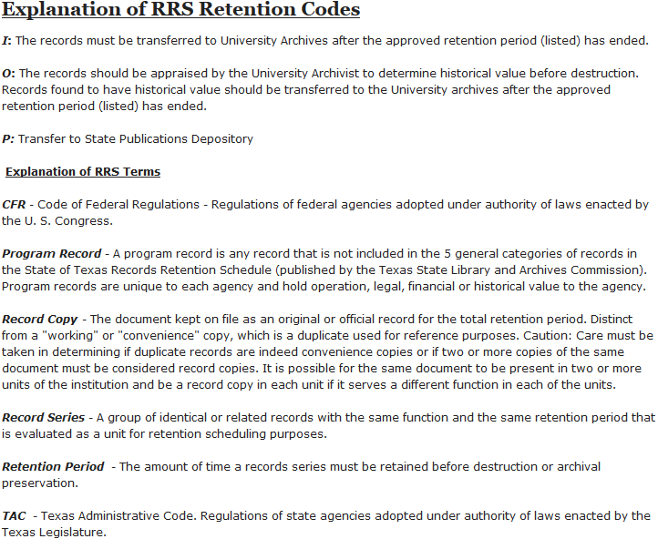

Slide 23
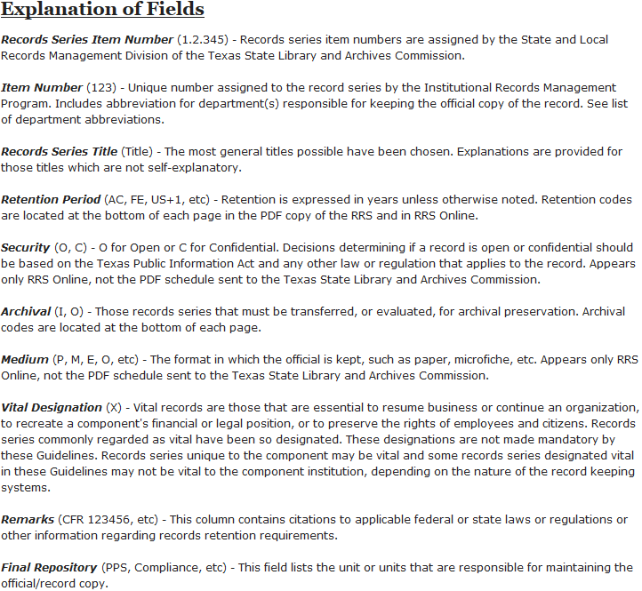

Slide 24
Reference to Codes
Archival Records(I) The records must be transferred to University archive after the approved retention period (listed) has ended.
Not all archival records are filed with the University Archive
Example: Financial Aid Records
Archival Records (O) Records that are reviewed by the University Archivist to determine historical value before disposition or destruction. Records found to have historical value should be transferred to the University archives after the approved retention period (listed) has ended.
Vital Records (X) Records that are essential to resume business or continue an organization, to recreate a component’s financial or legal position, or to preserve the rights of employees and citizens.

Slide 25
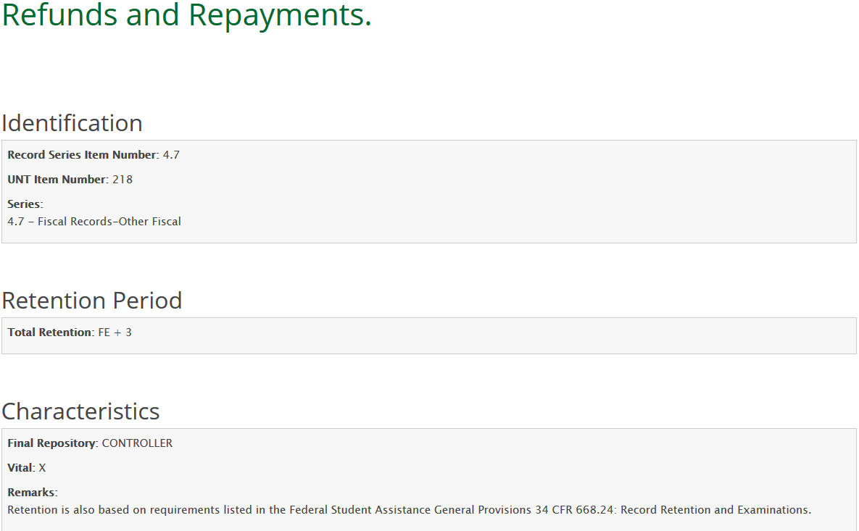

Slide 26
Wait! Archives? Archivist?
There is a University Archives for UNT System and UNT Denton at the Denton Campus and a University Archive at the Dallas Campus for UNT Dallas archival records.
The University Archive at Denton, is part of the Special Collections department of UNT Libraries.
The Special Collections department is responsible for many collections of rare and unique materials including faculty papers, organization archives, photography collections, rare books, maps and oral histories.
The Special Collections department and the University Archive at Dallas preserves official university records which have met their retention period and have enduring, historical value to the university and the community.
The records identified by the Archivist as having historical value are designated as “Archival” (I) or “Archival Review” (O) in the retention schedule.

Slide 27
University Archive and Archivist
Before sending materials to the archive, you must first file a Final Disposition Log with the Institutional Records Management Office, as well as get approval for disposition of records.
The Archivist will evaluate materials on a case-by-case basis. Only materials that are historically significant can be accepted to the archive.
Faculty papers and personal archives are not official university records but are donated to the university archive in some instances.
You may submit electronic records such as PDF documents and digital photos to the archive. There is no need to print materials.
To discuss the donation of non-official university records please contact the University Archivist.
UNT System and UNT
archivesrarebooks@unt.edu
UNT Dallas
Brenda.Robertson@untdallas.edu
972-338-1617

Slide 28
Disposition and Proper Disposal of Records
Final Disposition is the terminal treatment of a record, either by destruction or permanent storage in the University Archives. The disposition of records shall be documented on the Final Disposition Log (FDL).
In addition, records shall not be disposed of before their retention period and shall not be disposed of prior to approval of the FDL by our office. Units must use the current version of the FDL to list all records to be disposed of and send this log to the Institutional Records Management Program preferably through email to records@unt.edu.
It is advised to periodically check the records management website or with the records management office for updates.
If a record is not on the RRS, it cannot be disposed of.

Slide 29
Disposal of Confidential Records
Official records, convenience copies, or transitory information containing confidential information must be destroyed in a manner that preserves confidentiality throughout the entire disposition process.
Confidential information should never be placed in: the trash, unlocked recycling bins, or any other container that does not ensure adequate security of a record until it is permanently destroyed.

Slide 30
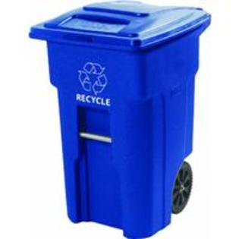
Recycling
A locked recycle bin is not permitted in a public hallway.
Units are to secure locked recycle bins behind at least one keyed door.
If this is not possible, access to the bin is to be monitored until it is locked in the business area.
All confidential information is to either be disposed of in a shredding machine or in a locked recycling bin.
UNT Denton Specific:
If there is an abundance of records, you can request pickup by UNT Recycling Services.
Confidential records being picked up should be labeled.
To make a request contact Work Control at 940-565-2700

Slide 31
Accessing and Completing the FDL
Access the most current Final Disposition Log at https://records.unt.edu/fdl/forms
There is a staff FDL and a faculty FDL.
Note: the faculty FDL is only a template, you will still need to add information to the document
After the FDL is completed and signed, scan and submit it to records@unt.edu or send it via intercampus mail to the Hurley Administration Building Suite 320F
The FDL is then reviewed by the Institutional Records Management Office.

Slide 32
Approval Process for the Final Disposition Log (FDL)
If more information is needed, the FDL will not be approved and it will require review, revision and resubmission.
If no errors are found, the FDL will be approved and notification will be given to your unit.
Records CANNOT be disposed until you get an approval from our office.
Note: For archival records, please wait for the FDL approval from the Institutional Records Management Office before contacting the University Archives for submission.
When submitting the FDL…
Keep in mind, the approved FDL is a record copy for the Office of
Institutional Records Management.
Handwritten submissions will not be approved
Must be legible; scanned FDLs must be absent of blurred content
Signatures must be clear and attestation box must be checked

Slide 33
Legal Holds
A university record may not be destroyed if any litigation, claim, negotiation, audit, open records request, administrative review, or other action involving the records is initiated before the expiration of the retention period for the records series in the approved Records Retention Schedule.
Its destruction shall not occur until the completion of the action and the resolution of all issues that arise from it.
Once the Office of General Counsel (OGC) notifies you that records are needed for litigation, DO NOT DESTROY ANY RECORDS, including those that have expired.
You could face criminal penalties.
Courts would assume that the records contained information favorable to the plaintiff.
If you receive a Public Information Request, please quickly forward it publicinformation@untsystem.edu
If you have any questions please contact the OGC the Public Information Coordinator at 940.565.2717

Slide 34
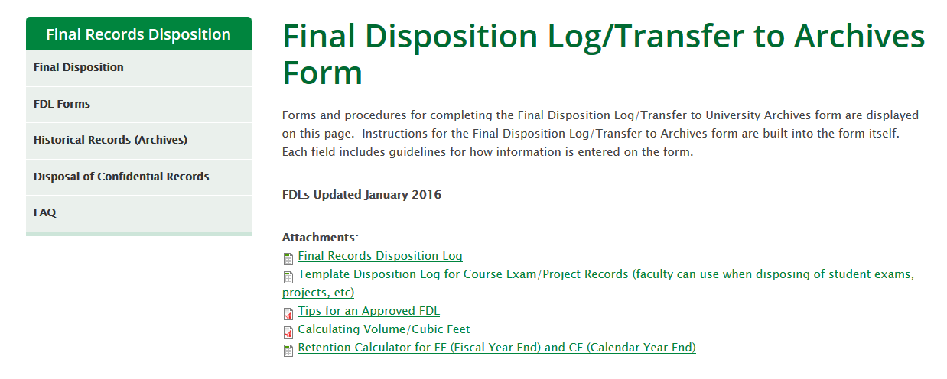

Slide 35
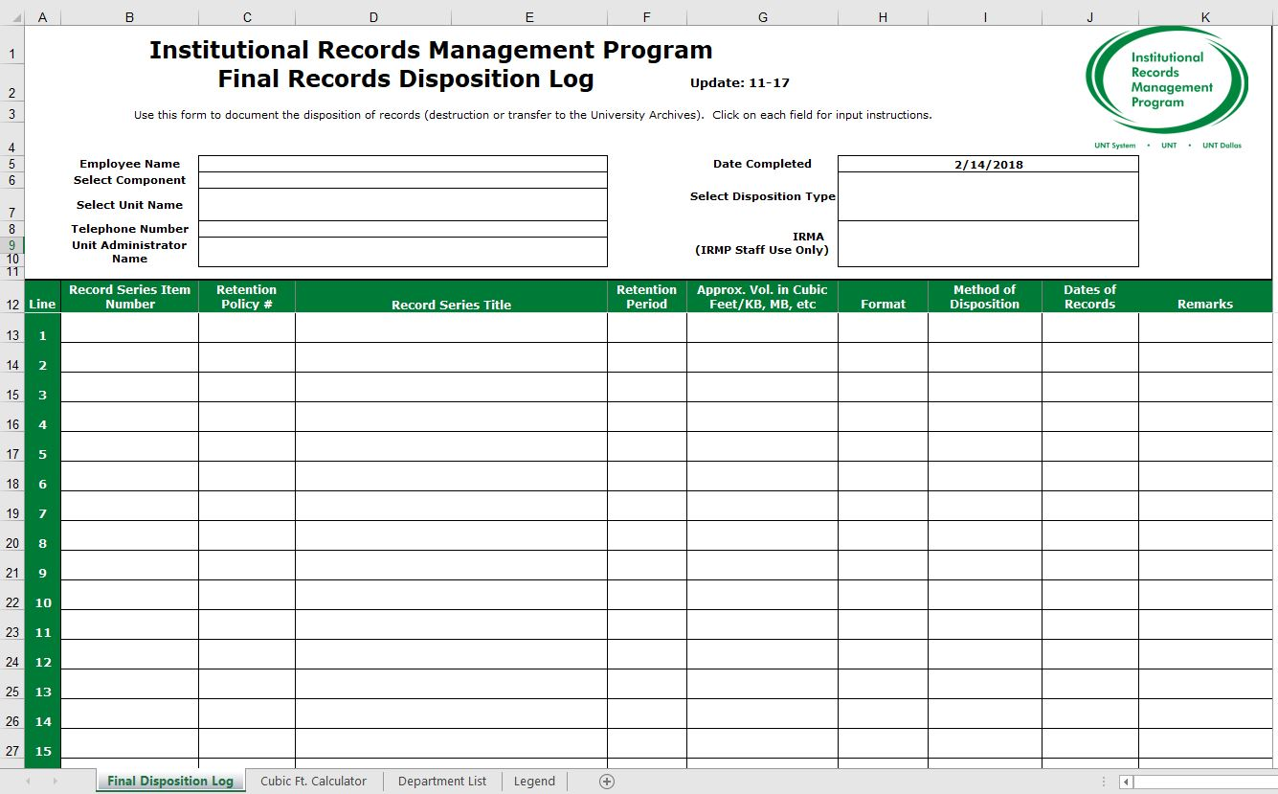
Final Disposition Log

Slide 36
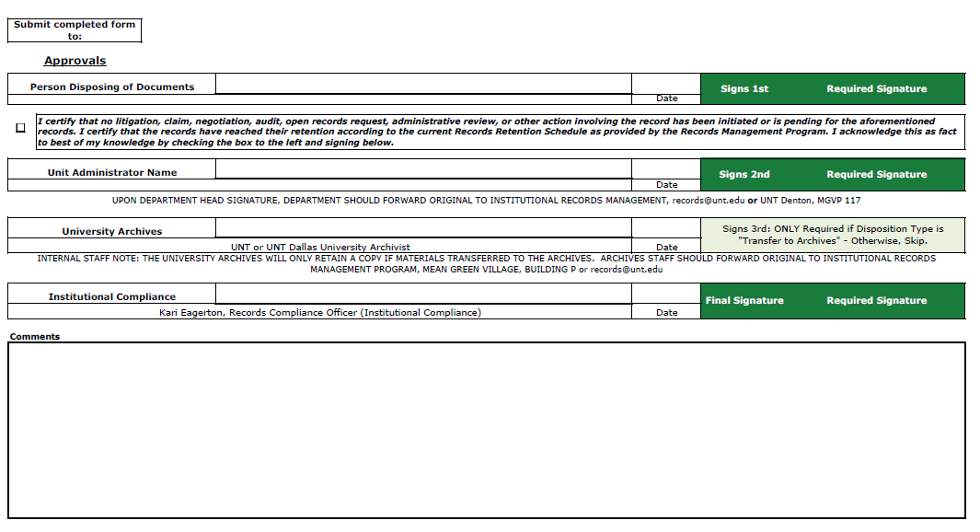
Final Disposition Log

Slide 37
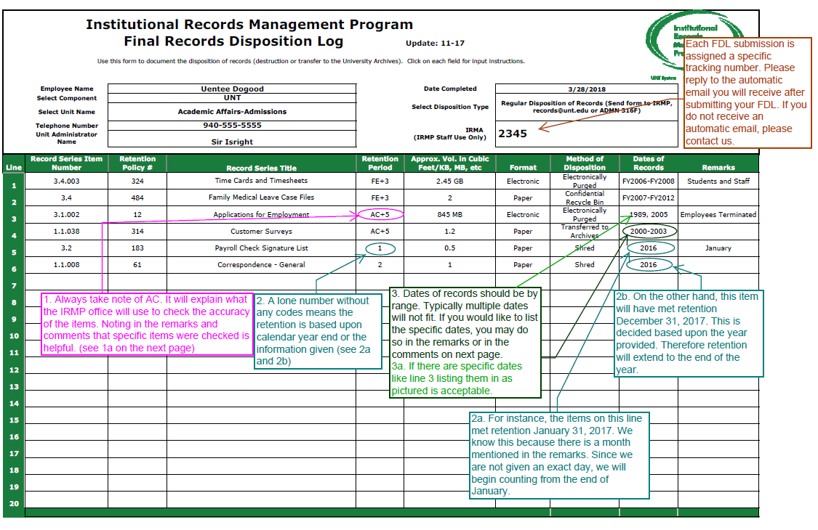

Slide 38
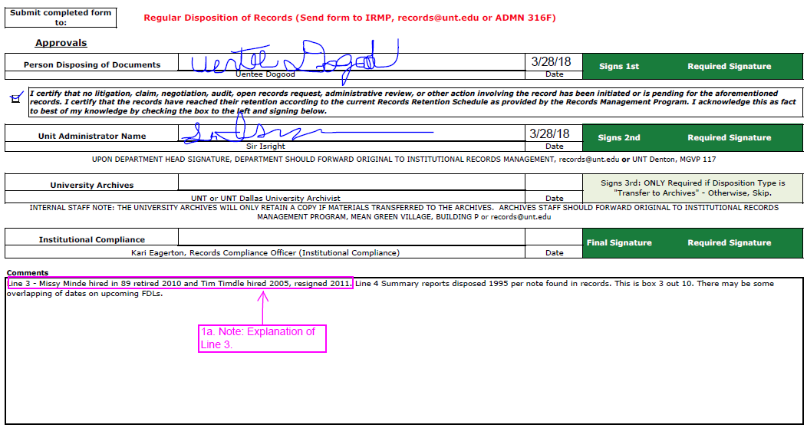

Slide 39
A Records Management Plan template is available at records.unt.edu for your convenience.
It is suggested that all units have a Records Management Plan (Inventory of Records)
This is a log of all the different records in your unit.
This log will assist you in determining where records fit in the Records Retention Schedule.

Slide 40
Document Types (DocTypes)
A DocType is a record with a retention period in accordance with the RRS. A DocType is used to identify a name of a record that is most useful to a unit and the unit’s function.
Units seeking to move their records to Perceptive Content Software will need DocTypes approved by the Institutional Records Management office prior to migrating records.
To request DocType approval, email records@unt.edu with the subject line “DocType Request” stating your name and the name of your unit.

Slide 41
Want to Know More? Visit our website at Records.unt.edu or contact
Kari Gerner
Records Compliance Officer
940-565-4171
Kari.Gerner@unt.edu

